Slide 1

Exploratory Data Analysis
XYZ Investment
July 6, 2023
Parwinder Singh - LISUM21

Slide 2
Agenda
Executive Summary
Problem Statement
Approach
EDA
EDA Summary
Recommendation

Slide 3
Executive Summary
V
I
Outcome: Comprehensive understanding of market for investment
Client: XYZ, a private firm in the US
Project Delivery: Presentation to XYZ's Executive team
IV
II
Goal: Provide valued information for XYZ's investment decision
III
Data: Multiple datasets on 2 cab companies, each representing different customer' aspects

Slide 4


Problem Statement
Dataset Overview
Multiple datasets with information on two cab companies.
Objective
Analyze data and provide actionable insights in choosing most suitable company for investment.
Data Analysis
Aim to uncover valuable insights about customer behavior, market dynamics, profitability, etc.
Investment Decision Support
Leverage data-driven insights to equip XYZ with necessary information.

Slide 5
Approach
Age Group Analysis
Company Comparison
Profitability Analysis
Expense Analysis
01
Uncover information about age group making up customer base
02
Sought to see if market was split evenly or dominated by one company
03
Understand which company is more profitable with investment
04
Discover which company will better use the investment within their business
All these analysis were made to figure out which company better handles their customers, profits, and expenses in order to determine the investment decision.

Slide 6
Hypothesis 1
I
Discover age demographics
III
Find high transaction Customer IDs
II
Reveal income status
Hypothesized 35–45-year-olds create the most profit for cab companies. Yellow Cab will have a higher revenue out of the sample group analyzed.

Slide 7
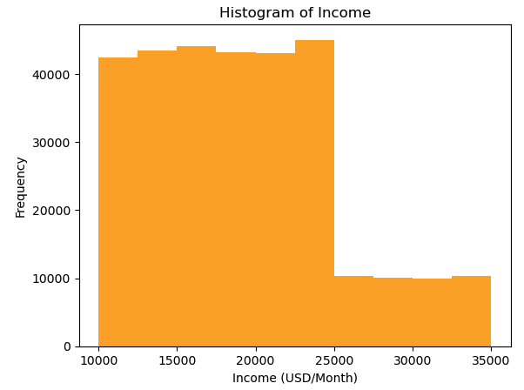
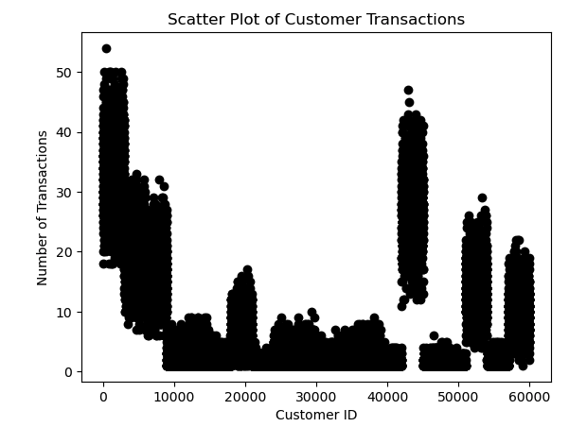
Discovered customer data with a mean age of 35.36
Captured significant portion of data from the 50th percentile to a little over the 75th percentile: Sample Age Group 35 – 45-year-olds
Coded a histogram of income levels and frequency of rides to see what areas drivers should target
Coded a scatter plot of Customer IDs to see how often riders seek taxi services
Discoveries:
Yellow Cab showed higher revenues by 6x compared to Pink Cab
Hypothesis holds true that Yellow Cab will have more revenue

Slide 8
Hypothesis 2
Aggregate and Group
Analyze City Data
Compare Metrics
Company Comparison
Aggregated Transaction IDs and grouped by City
Merged City data with aggregated counts to confirm alignment amongst Users and Transaction ID counts
Took previous queries and grouped by Company to see differences in Transaction IDs, KM Travelled, and Profit
A company comparison is in order due to the goal of investment. Hypothesize that Yellow Cab will outperform Pink Cab in all the chosen metrics.

Slide 9
Valuable Insights
 | Yellow Cab | Pink Cab
Transaction IDs | 274,681 | 84,711
KM Travelled | 8,625,380.27 KM | 2,768,194.82 KM
Profit | $44,020,373.17 | $5,307,328.32
As shown above it holds true that Yellow Cab will outperform Pink Cab as a company
Yellow Cab has 3x more Transaction IDs then Pink Cab
Even if Transaction IDs were evened out Yellow Cab will have much more profit than Pink Cab
Customers know Yellow Cab is dependable in long distance rides and that creates bias in everyday use

Slide 10
Hypothesis 3: Yellow Cab predicted to have more profits.
Predict profits in the future for both cab companies via Linear Regression models
Aggregated KM Travelled and Profit (Price Charged – Cost of Trip)
Grouped by Customer ID then Company in order to see each Customer IDs metrics with each company
Used the Profit and KM Travelled variables for the model

Slide 11
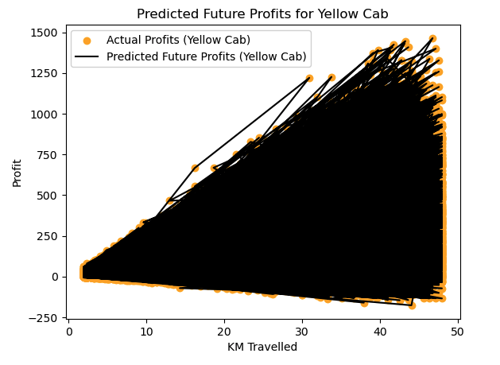
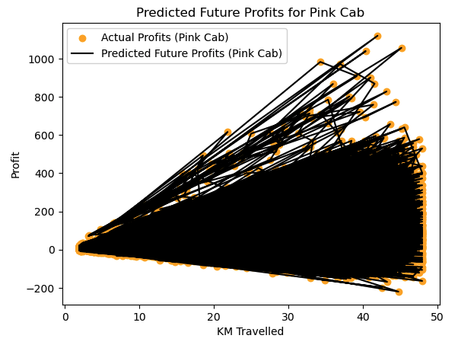
As shown above, Yellow Cab is predicted to have more high KM rides and earn more profit compared to Pink Cab
Investment should go to Yellow Cab due to customer and business success

Slide 12
Hypothesis 4: Pink Cab predicted to have less expenses.
Predict profits in the future for both cab companies via a Linear Regression model
Aggregated KM Travelled and Cost of Trip
Assumption: Cost of Trip stands for overall expenses
Grouped by Customer ID and Company
Used the Cost of Trip and KM Travelled variables for the model

Slide 13
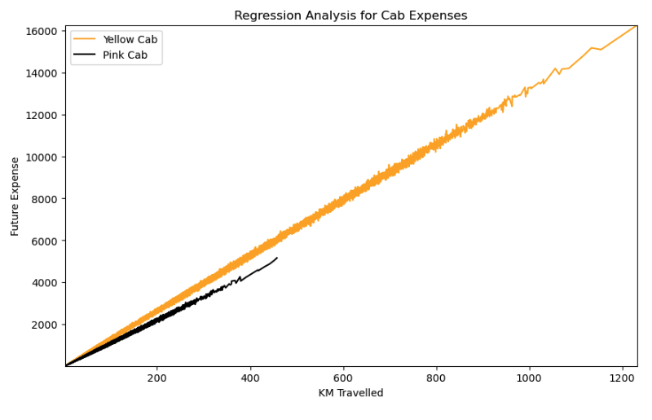
Valuable Insights:
Yellow Cab predicted to have higher expense count
Consider:
Yellow Cab transaction count is 274,681 and Pink Cab has 84,711
Yellow Cab has $40 million more in profit
Of course, Yellow Cab will have more expenses
However, Pink Cab has 32,330 unique customers and Yellow Cab has 39,896 unique customers. If an investment were to go into Pink Cab, you can experience more growth in the company while keeping expenses low and taking some of the business from Yellow Cab.

Slide 14
Hypothesis 5
Chose the most profitable group by analyzing low-income versus middle-income classes
I
Chose to analyze 35-45-year-olds in chosen group
III
Linear Regression Model between two chosen variables
V
Yellow Cab should be invested in
IV
II
Aggregated 'KM Travelled' and 'Profit'
Filtered out Transaction and Customer IDs
Yellow Cab will have higher profits in future from the filtered group of 35 – 45-year-olds

Slide 15
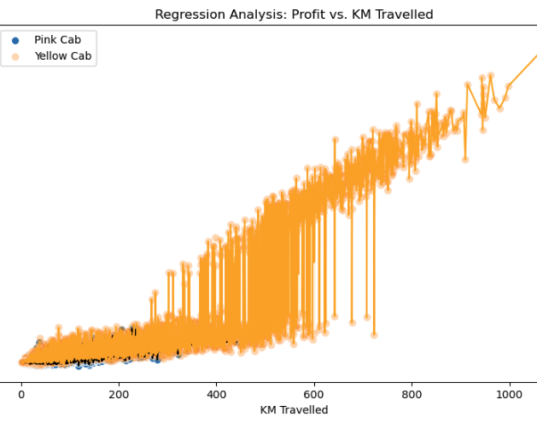
Analyzed low-income class
Both companies had low profits, chose not to analyze this class by itself
Initially started with:
Transaction Count
Pink Cab, 84,711
Yellow Cab, 274,681
Customer Count
Pink Cab, 32,330
Yellow Cab, 39,896
Filtered down to:
Transaction Count
Pink Cab, 20,250
Yellow Cab, 66,303
Customer Count
Pink Cab, 7,832
Yellow Cab, 9,662
Yellow Cab is predicted to increase their profits compared to Pink Cab, even with filtering down to even the playing fields as much as possible.

Slide 16
EDA Summary
Hypothesis 1
Invest in Yellow Cab due to its strong customer base and potential for business success
Hypothesis 2
Hypothesis 3
Invest in Yellow Cab due to its higher transaction counts, KM travelled, and higher profits compared to Pink Cab
Invest in Yellow Cab due to customers choosing the service for high KM rides compared to Pink Cab.
Hypothesis 4
Hypothesis 5
Invest in Pink Cab if you want potential for a lot of growth by increasing transaction counts or Yellow Cab and keep dominating the current market
Invest in Yellow Cab due to growth potential within profits compared to Pink Cab with low potential
Based on the analysis, it is recommended to invest in the Yellow Cab company due to its higher transaction counts, KM travelled, and profits compared to the Pink Cab company. This indicates a stronger market presence and potential for business success. Despite sharing customers, Yellow Cab demonstrates superior performance and presents better growth opportunities.

Slide 17
Questions regarding analysis?
Thank You

